Slide 1




Z01DT Information System in Business
Business analysis techniques and Project management methodologies
Roman Monsengwo Iyualeke
14536106
30/11 - 1/12

Slide 2

Introduction and Overview
Assumptions
Small business of around 50 people
Good customer service
Free and paid card plans
Free ATM withdrawals
0% foreign transaction fees
Lack of IT/software expertise
No Social media

Slide 3
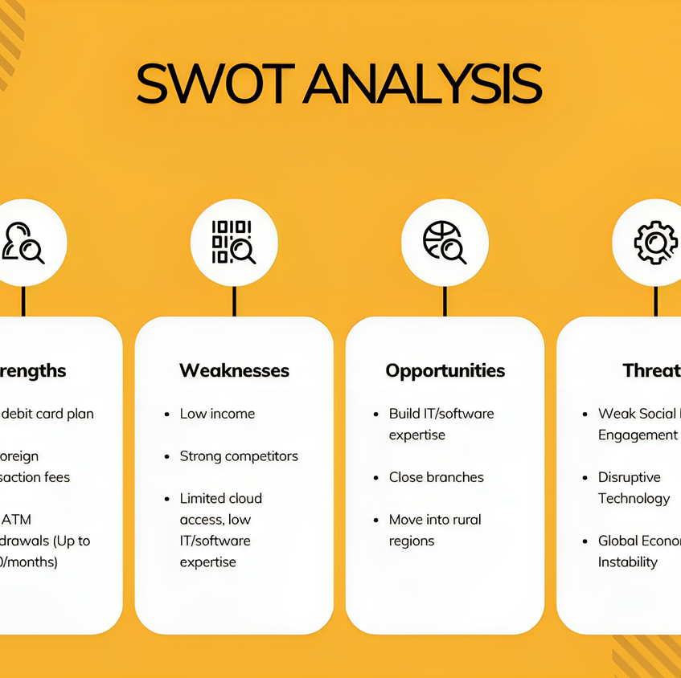
SWOT Analysis
“A SWOT analysis is a planning process that helps your company overcome challenges and determine which new leads to pursue.” (Schooley, 2023)

Slide 4


Slide 5
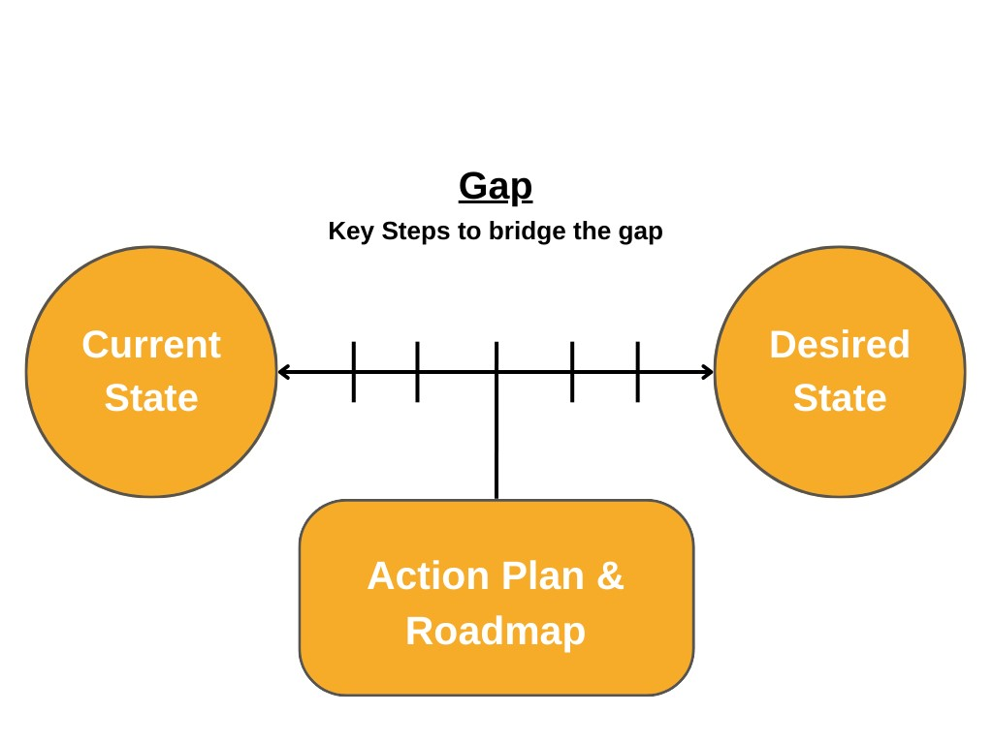
Gap Analysis
“This analysis is used to determine whether a company is meeting expectations and using its resources effectively.”(Hayes, 2023)

Slide 6
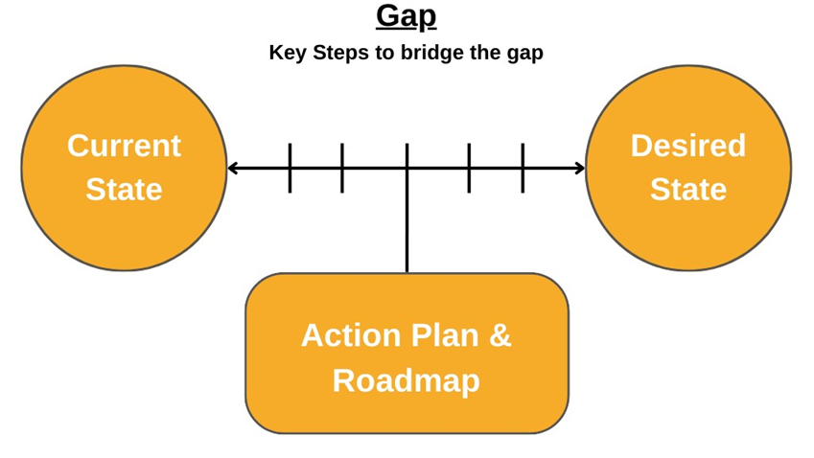
…
Extensive pure banking expertise and great plans
…

Slide 7

Gap
Near inexistant cloud coverage
Outdated legacy systems
Lack of “financial coverage”

Slide 8
…
Extensive pure banking expertise and great plans
Move to the cloud
Modernization
“Financial” Coverage

Slide 9
Extensive pure banking expertise and great plans
Cloud migration
Improve competitive position
“Financial” Coverage
Move to the cloud
Modernization
“Financial” Coverage

Slide 10
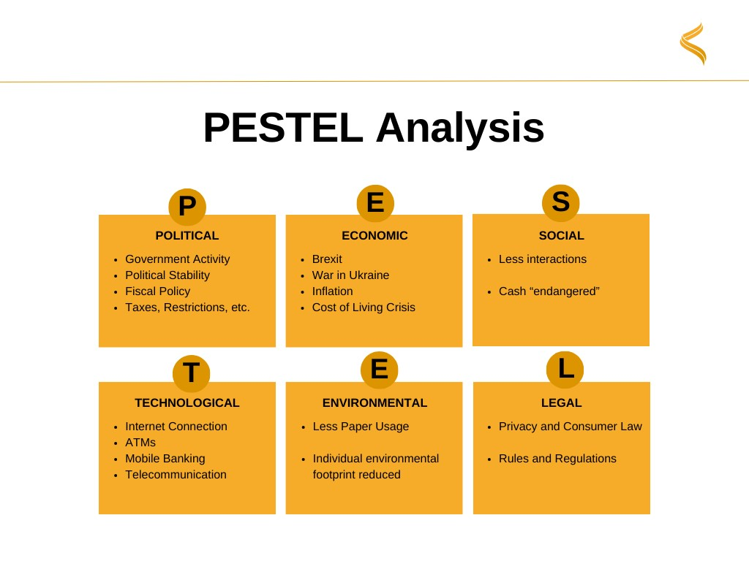
PEST/PESTEL/STEEPLE Analysis
“A PESTLE analysis can be used in a range of different scenarios and can guide people professionals and senior managers in strategic decision-making.” (CIPD,2023)

Slide 12

Four Corners Analysis
“Four Corner's Analysis is used to get into the mind of opposition and uses past behavior to predict future action, but actively tries to see if there is likely to be a shift in their strategy.” (Visual Paradigm)

Slide 13
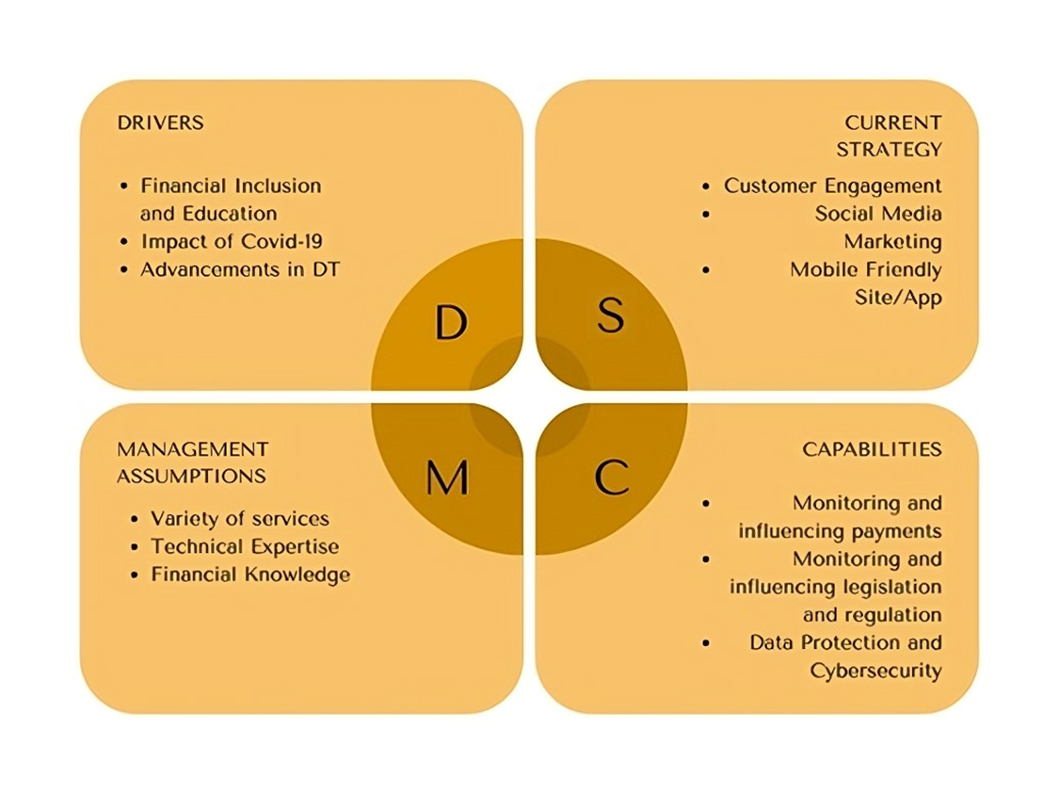
Competitor’s Future Strategy

Slide 14
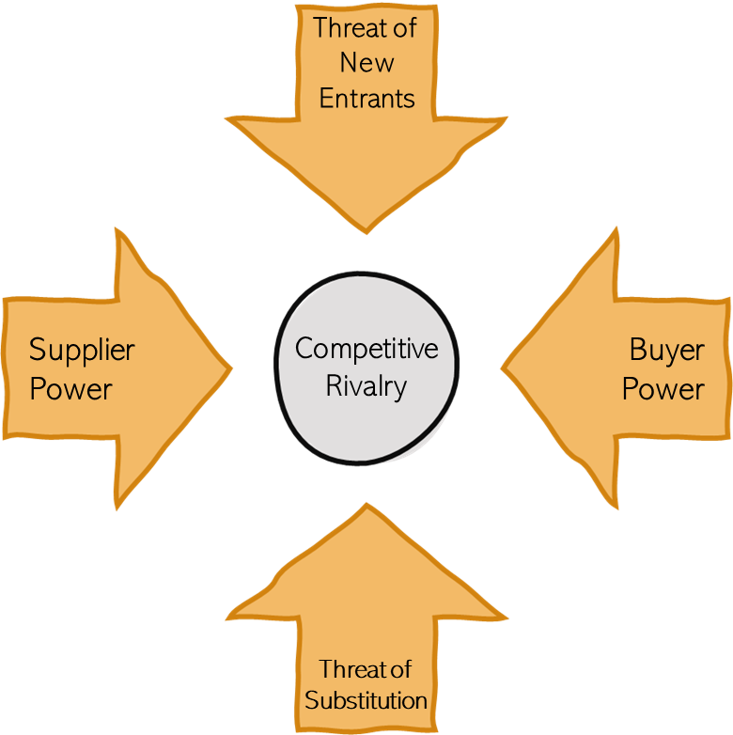
Porter’s Generic Strategies/Porter’s Five Forces
“Porter's Five Forces is a model that identifies and analyzes five competitive forces that shape every industry and helps determine an industry's weaknesses and strengths.” (Investopedia Team, 2023)

Slide 15


Threat of New Entrants
Low Threat
Differentiation
Well established
High Threat
Buyer dependant
Alternatives
Supplier
Power
Competitive
Rivalry
Buyer Power
Low Threat
Depositors
HR
High Threat
Not the best
FinTech
Threat of Substitution

Slide 16
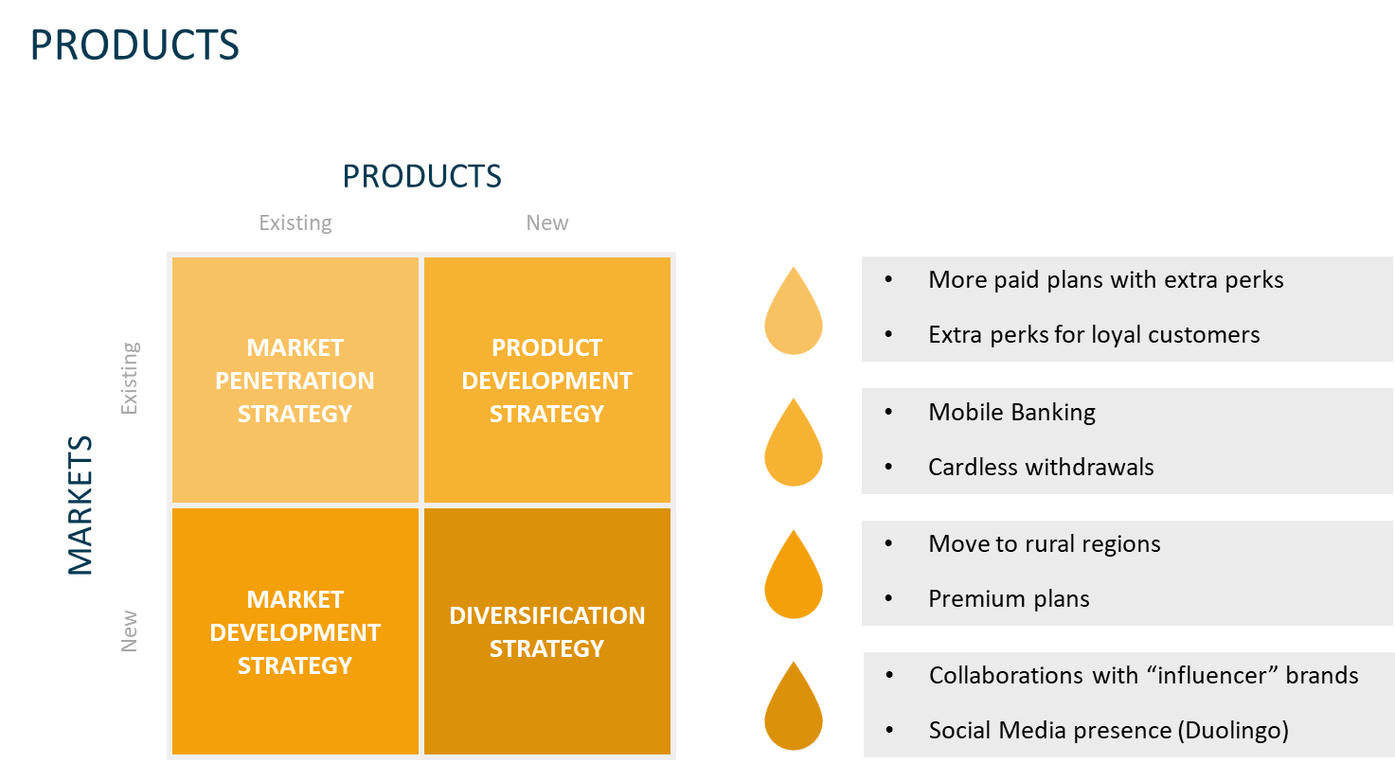
Ansoff Matrix
“The Ansoff Matrix is a simple and intuitive way to visualize the levers a management team can pull when considering growth opportunities.” (Peterdy)

Slide 17
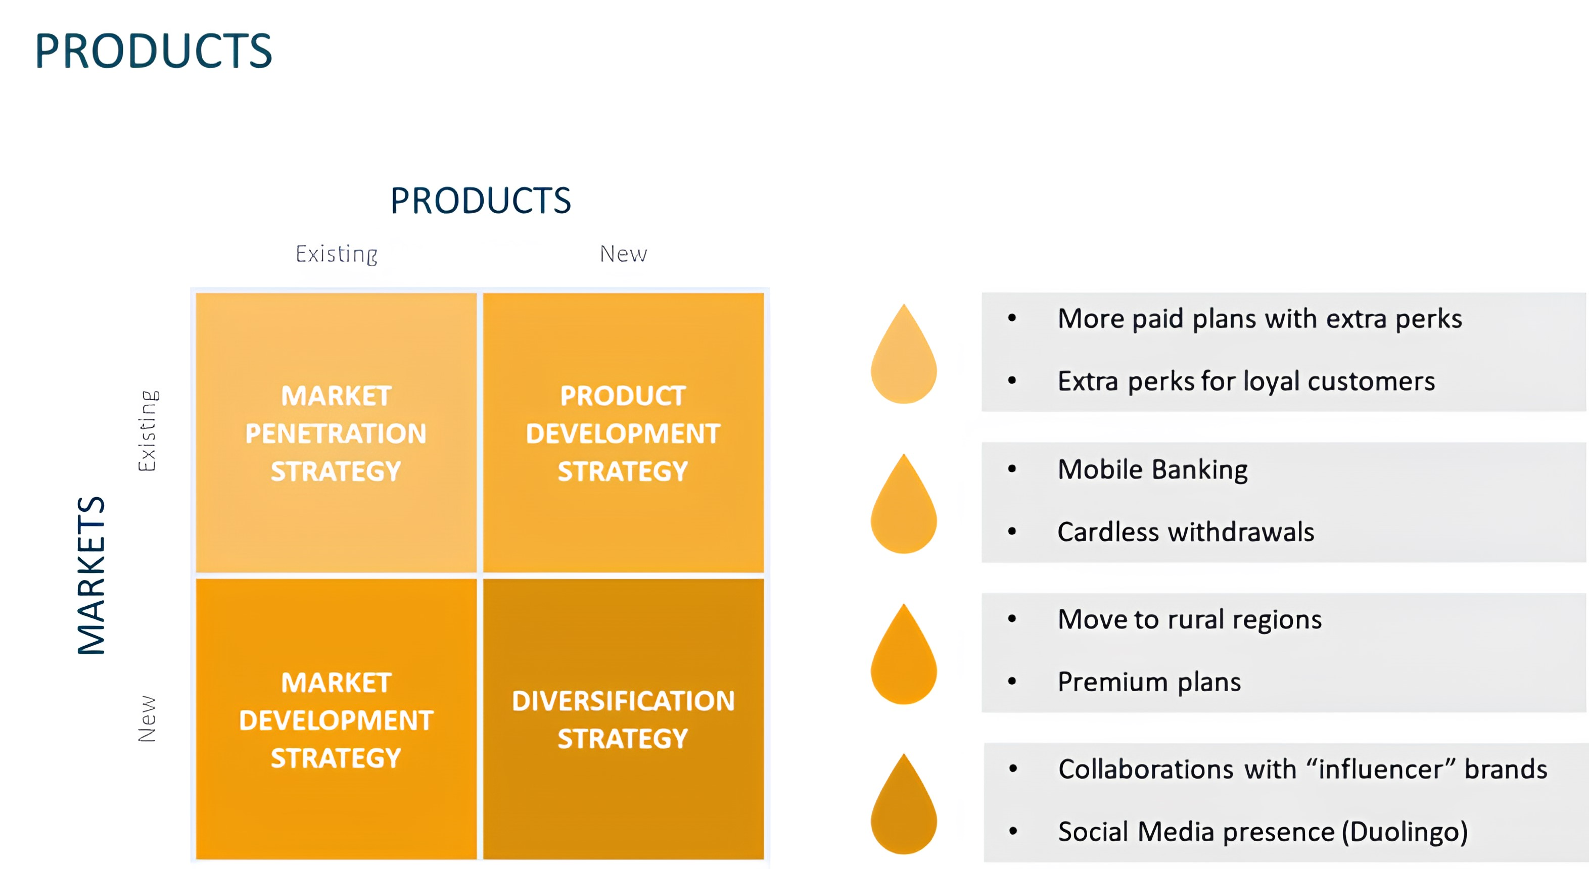

Slide 18


Competitive Advantage
Competitive advantage are factors or circumstances that allows a company to have the upper hand on their rivals in the market.
Solid relationships
Great plans with great benefits
Easier to communicate

Slide 19

Project Management approaches
Hybrid methodology: Agile & Kanban
(Speed, Collaboration & Organization)

Slide 20

Conclusion

Slide 21
References
CIPD. (2023). PESTLE analysis.
https://www.cipd.org/en/knowledge/factsheets/pestle-analysis-factsheet/
Hayes A. (2023). What Is a Gap Analysis? Investopedia.
https://www.investopedia.com/terms/g/gap-analysis.asp
Investopedia Team. Porter’s 5 Forces Explained and How to Use the Model.
https://www.investopedia.com/terms/p/porter.asp
Peterdy K. Ansoff Matrix. CFI.
https://corporatefinanceinstitute.com/resources/management/ansoff-matrix/
Schooley S. (2023). What is a SWOT Analysis ? (And When To Use It). Business News Daily.
https://www.businessnewsdaily.com/4245-swot-analysis.html
Visual Paradigm. What is Four Corners Analysis?
https://www.visual-paradigm.com/guide/strategic-analysis/what-is-four-corners-analysis/

Slide 22
Bibliography
Adobe Experience Cloud Team. (2023). Popular project management methodologies.
https://business.adobe.com/blog/basics/methodologies
Ayush K. (2021). What is Four Corner’s Analysis?
https://www.analyticssteps.com/blogs/what-four-corners-analysis
BDC. Competitive Advantage.
https://www.bdc.ca/en/articles-tools/entrepreneur-toolkit/templates-business-guides/glossary/competitive-advantage#:~:text=A%20competitive%20advantage%20is%20anything,a%20lower%20cost%20than%20competitors
CIPD. (2023). PESTLE analysis.
https://www.cipd.org/en/knowledge/factsheets/pestle-analysis-factsheet/
Elsaid H. (2023). 5 factors driving the rise of fintech in the financial services industry.
https://www.tradefinanceglobal.com/posts/5-factors-driving-rise-fintech-financial-services-industry/
Farooq U. SWOT Analysis of the Banking Industry.
https://www.marketingtutor.net/swot-analysis-of-the-banking-industry/
Frue K. (2017). PESTLE Analysis for the Banking Industry.
https://pestleanalysis.com/pestle-analysis-for-banking-industry/#Sociocultural_factors_Consumers_want_ease
Frue K. (2019). SWOT Analysis of the Banking Industry.
https://pestleanalysis.com/swot-analysis-of-the-banking-industry/#Threats
Hayes A. (2023). What Is a Gap Analysis? Investopedia.
https://www.investopedia.com/terms/g/gap-analysis.asp

Slide 23
Investopedia Team. Porter’s 5 Forces Explained and How to Use the Model.
https://www.investopedia.com/terms/p/porter.asp
Kagan J. (2023). Financial Technology (Fintech): Its Uses and Impact on Our Lives
https://www.investopedia.com/terms/f/fintech.asp#:~:text=Examples%20of%20fintech%20applications%20include,and%20crypto%20apps%2C%20among%20others.
Lucidchart. What is gap analysis ? 4 steps and examples to use.
https://www.lucidchart.com/blog/what-is-gap-analysis#:~:text=What%20Is%20a%20gap%20analysis,shortcomings%20and%20opportunities%20for%20improvement.
Mileva G. Top 10 Most Effective Marketing Strategies for FinTech Industry in 2023.
https://ninjapromo.io/fintech-marketing-strategies#:~:text=Customer%20engagement%20is%20crucial%20for,worked%20for%20many%20fintech%20apps.
Peterdy K. Ansoff Matrix. CFI.
https://corporatefinanceinstitute.com/resources/management/ansoff-matrix/
Schooley S. (2023). What is a SWOT Analysis ? (And When To Use It). Business News Daily.
https://www.businessnewsdaily.com/4245-swot-analysis.html
Sidley. Fintech Capabilities.
https://www.sidley.com/en/us/services/banking-and-financial-services/fintech/sub-pages/fintech-capabilities/
Visual Paradigm. What is Four Corners Analysis?
https://www.visual-paradigm.com/guide/strategic-analysis/what-is-four-corners-analysis/
Wondershare EdrawMax. Detailed PESTEL Analysis of Banking Industry.
https://www.edrawmax.com/article/banking-industry-pestel-analysis.html

